Slide 1

BANK CRM
Name: Ashwin Dubey
Inst name: Newton School
Date of Submission; 30-05-2024

Slide 2
RowNumber: The row number in the dataset, likely used for reference or indexing.
CustomerId: A unique identifier for each customer.
CreditScore: A numerical representation of the customer's creditworthiness.
Credit score:
Excellent: 800–850
Very Good: 740–799
Good: 670–739
Fair: 580–669
Poor: 300–579
GeographyID: A numerical identifier that likely corresponds to a geographical location, such as a country or region.
GenderID: A numerical identifier for the customer's gender, where for example, '1' could represent male and '2' could represent female.

Slide 3
Age: The age of the customer.
Tenure: The number of years the customer has been with the bank.
Balance: Current balance in the customer's account.
NumOfProducts: refers to the number of products that a customer has purchased through the bank.
HasCrCard: denotes whether or not a customer has a credit card. This column is also relevant, since people with a credit card are less likely to leave the bank.
1 represents credit card holder
0 represents non credit card holder
IsActiveMember: active customers are less likely to leave the bank (as per the criteria defined by the bank for identifying the activeness).
1 represents Active Member
0 represents Inactive Member
Estimated Salary: as with balance, people with lower salaries are more likely to leave the bank compared to those with higher salaries.
Exited: whether or not the customer left the bank.
0 represents Retain
1 represents Exit

Slide 4
Customer Churn and its impact on business
Customer churn, the rate at which customers stop using a company's products or services, is a crucial metric for banks.
It directly impacts revenue and profitability.
In this presentation, we will analyze our bank's customer churn rates, focusing on gender, recent years, customers with credit cards, number of products used, credit score-wise churn count, and geography-wise churn count.
Our goal is to identify factors contributing to churn and propose strategies to improve customer retention and satisfaction

Slide 5

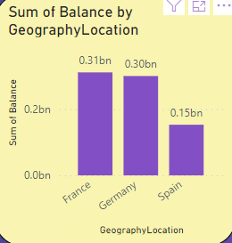
OBJECTIVE INSIGHT
Account Balance in different Regions
France | Germany | Spain
France have Highest Balance among the three countries. Nearly about 0.31 Billion. | Germany is 2nd most country having Balance among the three country and slightly lower then France. France noted Balance is 0.30 billion. | Spain is lower among all the three country. It is almost half of Germany’s balance. Recorded balance in Spain is 0.15 billion.

Slide 6


Churn rate by gender in most recent year
15.37
The churn rate by gender is calculated by gender count / total customer (Customer ID)
By this we can clear see that male churn ratio is less then the female ratio.
This is calculated for year of 2019 because this is the most recent year in the dataset.
25.05

Slide 7
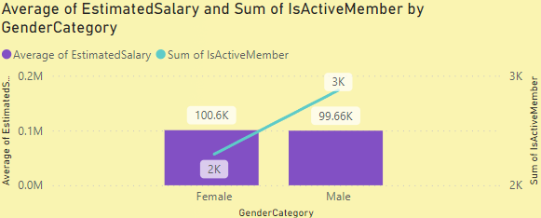
Gender with higher Estimated salary and how it relates to number of active accounts
Axis:The horizontal axis represents the Gender Category, while the vertical axis has two scales: one for the Average of EstimatedSalary and the other for the Sum of IsActiveMember
Data Representation: There are two sets of bars for each gender category; one set represents the Average of EstimatedSalary, and the other represents the Sum of IsActiveMember.
Key Observations:
The average estimated salary is approximately the same for both genders, with Female at around 100.6K and Male at around 99.6K.
The sum of active members is higher for males, close to 3K, compared to just over 2K for females
By this we can easily conclude that Average Estimated salary of female if high for low sum of active member as compared to male candidates.

Slide 8
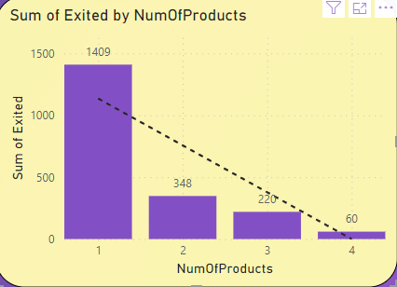

Common number of product used by the customer who exited
: The sum of exits decreases as the number of products increases. Specifically, the sum of exits is highest for 1 product (approximately 1409), and lowest for 4 products (around 60).
There is a clear downward trend in the sum of exits as the number of products increases. This could imply that having more products leads to fewer exits, which might be a point of interest for further analysis or discussion.

Slide 9
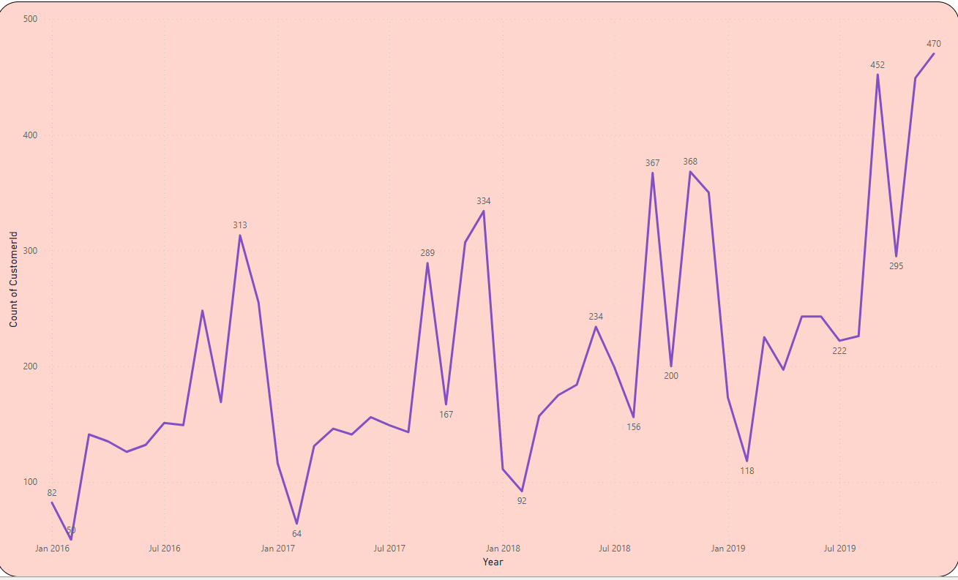
The trend of customers joining over time and identify any seasonal patterns (yearly or monthly)
Notable Peaks: There are notable peaks in April 2016 with approximately 518 counts and in July 2019 nearing the count of approximately 425.
Significant Dip: There is a significant dip near July 2017 at about 267 counts.
Overall Trend: Despite the fluctuations, there seems to be an overall upward trend in the count of CustomerId over the years.

Slide 10


Rank of Locations as per the number of people who have churned the bank
This is solved in SQL by window functions.
From the output we got can be seen that Germany is the country where churned count is Maximum (814) and ranked 1st while France ranked 2nd among all with the churned count as 810.
Churned difference between this two country is slightly different.
Spain is the country where churned count is minimum and ranked as 3rd with churn count as 413. Spain churn count is almost half of remaking two country.

Slide 11
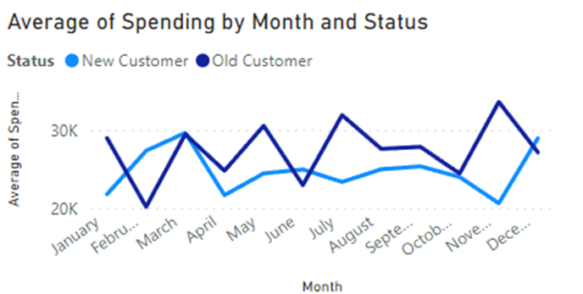
SUBJECTIVE INSIGHT
Customer Behaviour Analysis
This graph tells us that spending of new customers (2019) is lower through out an year as compared to Old customer (2019-2018.
There is a point where both has spend nearly same and that is month of March.
This month is a favourable for customer to spend several reason could be for this.

Slide 12
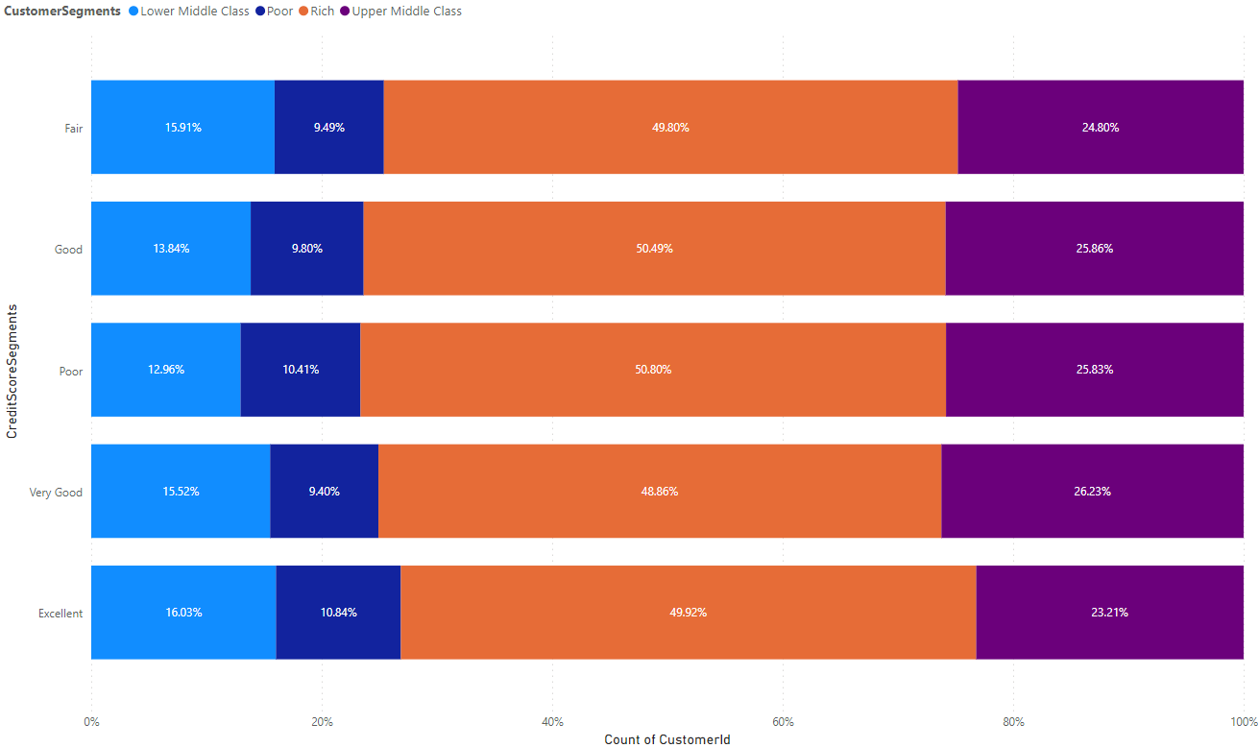
Risk Management Assessment
Based on the chart, the demographic segments with the most customers are those with lower credit scores ("Lower Middle Class" and "Poor"). These same segments also represent the largest portion of the bank's customers.
Customers with lower credit scores are statistically more likely to default on loans than customers with high credit scores. This means that the bank is more likely to lose money on loans made to customers in the "Lower Middle Class" and "Poor" segments than on loans made to customers in other segments.

Slide 13
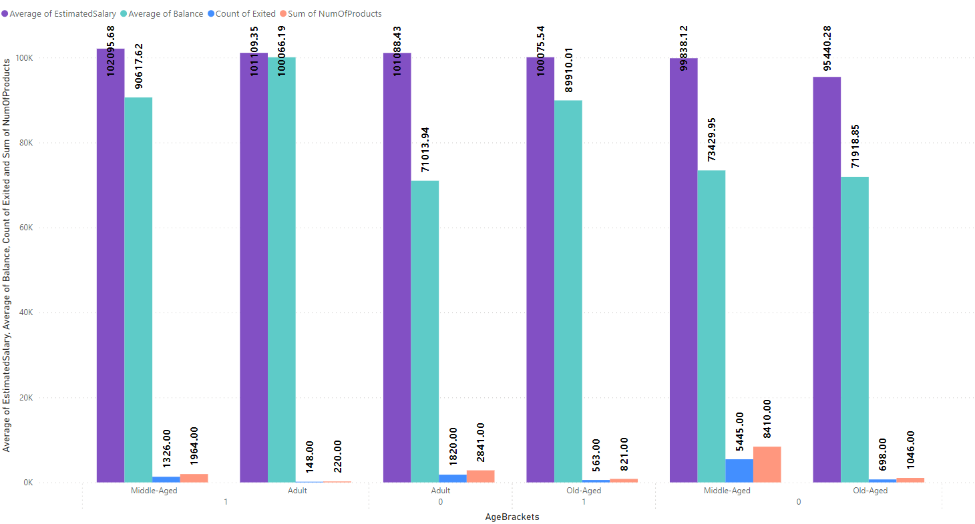
Customer Exit Reasons Exploration
Geographical Location: Customers from Germany show a higher count of exited individuals compared to those from France and Spain.
Credit Card Ownership: The presence of a credit card does not show a significant difference in exit counts.
Membership Activity: Inactive members have a noticeably higher exit count than active members.
Number of Products: Customers with only one product have the highest exit count compared to those with more products.

Slide 14
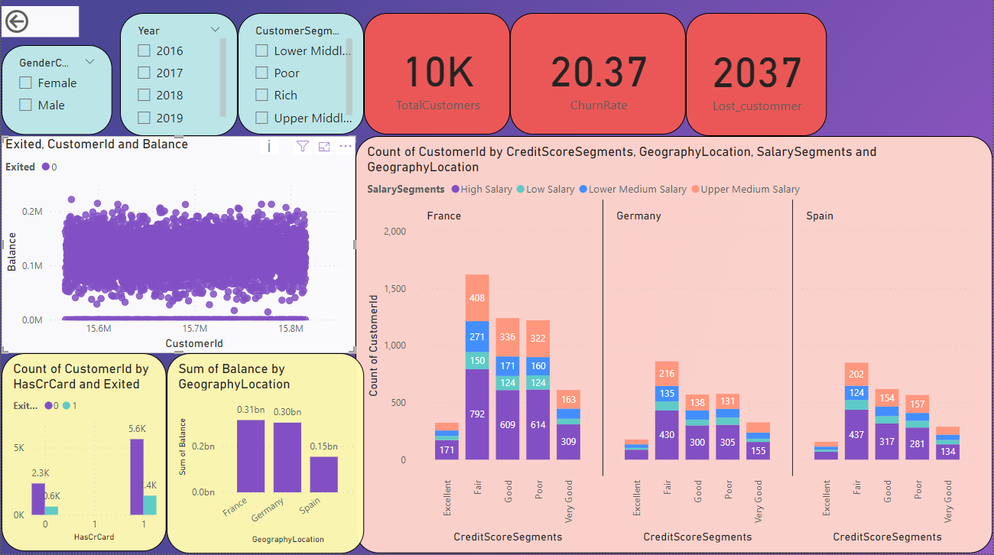
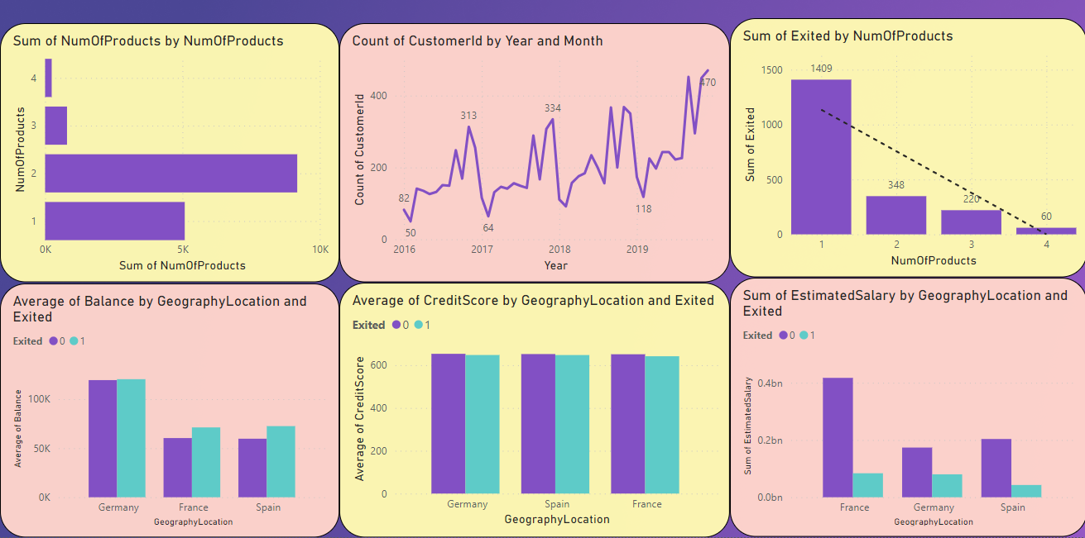
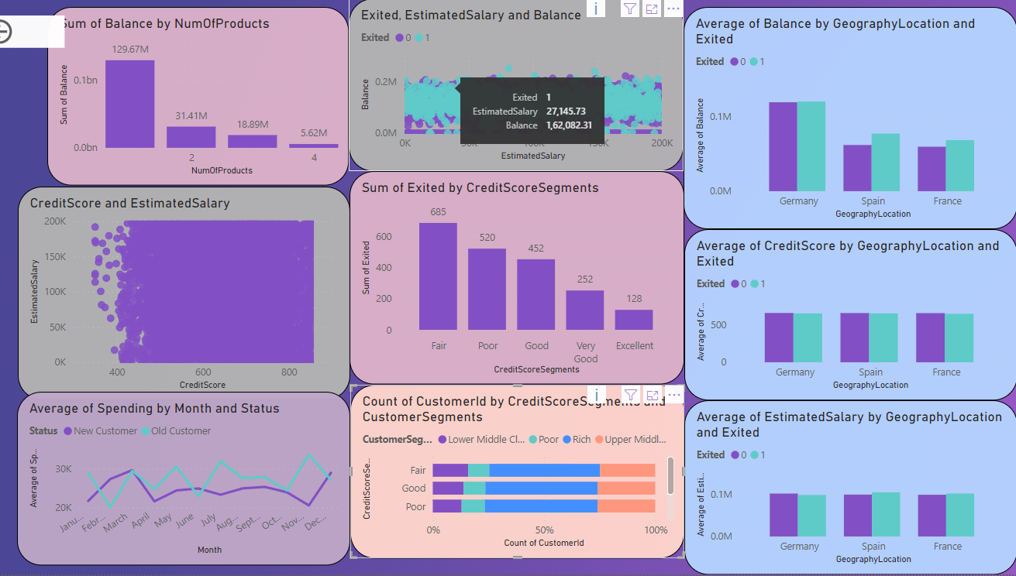
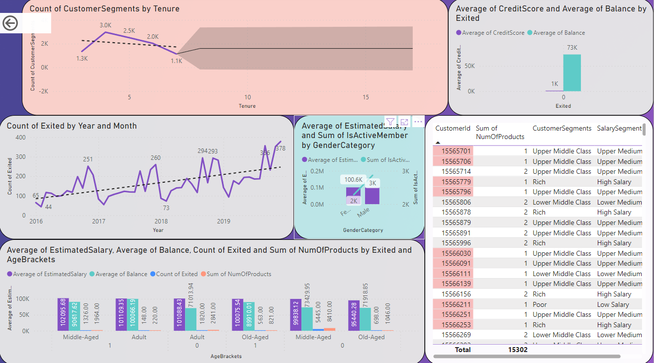
DASHBOARD

Slide 15

REFERENCE
All visualisation is done in Power BI
Calculation part where ever necessary is done in SQL.
In class of NEWTON SCHOOL information gained by Kumar Umesh Thatikonda for SQL.
In class of NEWTON SCHOOL information gained by Miss Kale for Power BI.

Slide 16
THANK YOU

